Slide 1
第20、21讲 应用层安全 电子邮件安全

Slide 2
Email 安全
电子邮件是使用最广泛的网络服务
当前电子邮件的消息内容存在安全隐患
在传输过程中可能被查看
在邮件服务器中被特权管理员查看
Notes:
In virtually all distributed environments, electronic mail is the most heavily used network-based application. But current email services are roughly like "postcards”, anyone who wants could pick it up and have a look as its in transit or sitting in the recipients mailbox.

Slide 3
电子邮件安全涉及多个方面
保密性
防止邮件泄露
认证性
发送方身份认证
邮件完整性
防止邮件被修改
不可否认性
防止发送方否认曾发送过邮件
Notes:
With the explosively growing reliance on electronic mail for every conceivable purpose, there grows a demand for authentication and confidentiality services. What we want is something more akin to standard mail (contents protected inside an envelope) if not registered mail (have confidence about the sender of the mail and its contents). That is, the “classic” security services listed are desired.

Slide 4
1. PGP协议：Pretty Good Privacy
使用广泛，事实上的邮件安全标准
由Phil Zimmermann开发
使用当前最好的密码算法
提供单一的软件实现： Unix，Windows，Mac皆有实现
免费，当前也有商业版本
Notes:
The Pretty Good Privacy (PGP) secure email program, is a remarkable phenomenon, has grown explosively and is now widely used. Largely the effort of a single person, Phil Zimmermann, who selected the best available crypto algorithms to use & integrated them into a single program, PGP provides a confidentiality and authentication service that can be used for electronic mail and file storage applications. It runs on a wide range of systems, in both free & commercial versions.

Slide 5
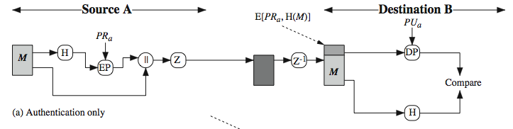
PGP 功能：消息认证
发送方准备待发送消息
计算消息摘要（SHA-1160-bit）
使用RSA签名消息摘要
接收方使用签名算法验证消息摘要正确性
接收方使用加密算法及摘要，验证消息正确性
Notes:
The actual operation of PGP, as opposed to the management of keys, consists of four services: authentication, confidentiality, compression, and e-mail compatibility. Stallings Figure 18.1a illustrates the digital signature service provided by PGP. This is the digital signature scheme discussed in Chapter 13 and illustrated in Figure 7.2. The sequence is as listed. Note this assumes use of RSA digital signatures, created using the sender's private key, and verified with the sender's public key. Recent PGP versions also support the use of DSS signatures. Signatures can also be detached from a message/file and sent/stored separately. This can be useful to maintain a separate signature log of all messages sent or received; or on an executable program to detect subsequent virus infection, or when more than one party must sign a document.

Slide 6
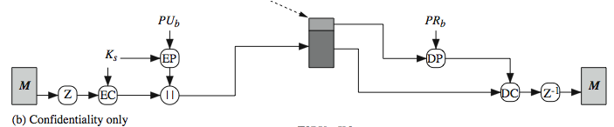
PGP 功能：消息保密
发送方生成128bit随机会话密钥
使用会话密钥加密消息
使用RSA加密会话密钥，并附加于消息
接收方先解密会话密钥
接收方进而解密消息
Notes:
Another basic service provided by PGP is confidentiality, provided by encrypting messages to be transmitted or to be stored locally as files, using symmetric encryption algorithms CAST-128, IDEA or 3DES in 64-bit cipher feedback (CFB) mode. The randomly chosen session key used for this is sent encrypted using the recipient’s public RSA key. The steps used in this process are as listed. Stallings Figure 7.1b illustrates the sequence. Recent PGP versions also support the use of ElGamal (a Diffie-Hellman variant) for session-key exchange.

Slide 7
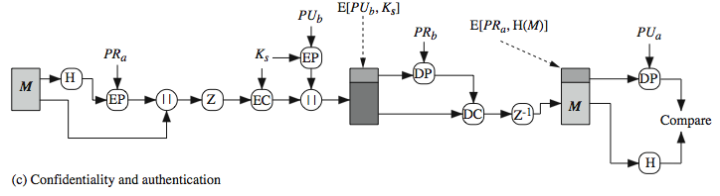
PGP 功能：消息认证及保密
即同时使用认证及保密功能
生成签名，附加于消息
同时加密消息、签名
附加会话密钥
Notes:
As Stallings Figure 18.1c illustrates, both confidentiality & authentication services may be used for the same message. Firstly a signature is generated for the plaintext message and prepended to the it. Then the plaintext message plus signature is encrypted using CAST-128 (or IDEA or 3DES), and the session key is encrypted using RSA (or ElGamal). This sequence is preferable to the opposite: encrypting the message and then generating a signature for the encrypted message. It is generally more convenient to store a signature with a plaintext version of a message. Furthermore, for purposes of third-party verification, if the signature is performed first, a third party need not be concerned with the symmetric key when verifying the signature. In summary, when both services are used, the sender first signs the message with its own private key, then encrypts the message with a session key, and then encrypts the session key with the recipient's public key.

Slide 8
PGP 功能：压缩
默认情况下，PGP签名后、加密前压缩待加密消息
因而，可以先存储消息，验证可以延后
压缩是非确定性的
使用ZIP压缩算法
Notes:
By default PGP compresses the message after applying the signature but before encryption. This has the benefit of saving space both for e-mail transmission and for file storage. The signature is generated before compression for the reasons shown. The compression algorithm used is ZIP, and is indicated by Z for compression and Z–1 for decompression in Figure 18.1. It is described in Online Appendix O.

Slide 9
PGP 功能：邮件兼容性
邮件发送协议仅支持文本，如何处理任意二进制数据？
需要转化为ASCII字符
使用radix-64编码算法：将3字节，映射为4个可打印的ASCII字符
如果消息过大，PGP也会分割消息
Notes:
When PGP is used, at least part of the block to be transmitted is encrypted, and thus consists of a stream of arbitrary 8-bit octets. However many electronic mail systems only permit the use of ASCII text. To accommodate this restriction, PGP provides the service of converting the raw 8-bit binary stream to a stream of printable ASCII characters. It uses radix-64 conversion, in which each group of three octets of binary data is mapped into four ASCII characters. The use of radix 64 expands a message by 33%. Fortunately, the session key and signature portions of the message are relatively compact, and the plaintext message has been compressed, often by more than enough to compensate for the radix-64 expansion. This format also appends a CRC to detect transmission errors. See Stallings Appendix 18A for a description.
PGP also automatically subdivides a message that is too large for a single email, into segments that are small enough to send.

Slide 10
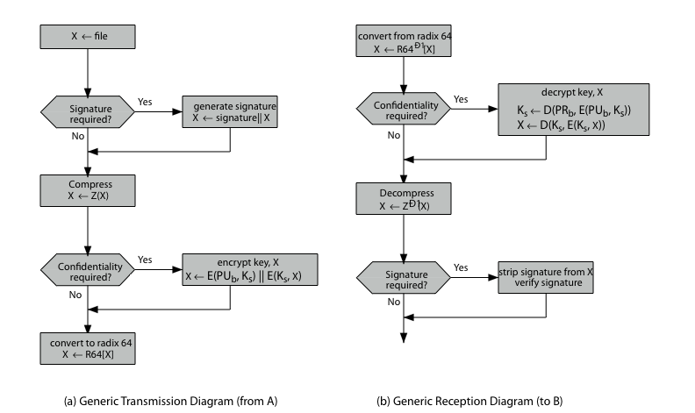
PGP 功能：总结
Notes:
Stallings Figure 18.2 illustrates the general operation of PGP, and the relationship between the services discussed. On transmission, if it is required, a signature is generated using a hash code of the uncompressed plaintext. Then the plaintext, plus signature if present, is compressed. Next, if confidentiality is required, the block (compressed plaintext or compressed signature plus plaintext) is encrypted and pre-pended with the public-key-encrypted symmetric encryption key. Finally, the entire block is converted to radix-64 format.
On reception, the incoming block is first converted back from radix-64 format to binary. Then, if the message is encrypted, the recipient recovers the session key and decrypts the message. The resulting block is then decompressed. If the message is signed, the recipient recovers the transmitted hash code and compares it to its own calculation of the hash code.

Slide 11
2. S/MIME协议
Secure/Multipurpose Internet Mail Extensions
对MIME协议做了安全性增强
初始RFC5322邮件协议仅支持文本发送
多用途网际邮件扩展MIME提供了多种数据类型发送及消息分块，技术上使用Radix 64编码
S/MIME 增加了安全性
多个软件支持S/MIME
e.g. MS Outlook, Mozilla, Mac Mail 等
Notes:
S/MIME (Secure/Multipurpose Internet Mail Extension) is a security enhancement to the MIME Internet e-mail format standard, which in turn provided support for varying content types and multi-part messages over the text only support in the original Internet RFC822 (now RFC5322) email standard. See text for discussion of these extensions. MIME is specified in RFCs 2045 through 2049. MIME allows encoding of binary data to textual form for transport over traditional RFC822 email systems. S/MIME support is now included in many modern mail agents.

Slide 12
S/MIME 功能
数据保密（enveloped data）
加密内容及密钥
数据签名（signed data）
消息编码 + 摘要签名
仅签名消息（clear-signed data）
未编码消息 + 编码后摘要签名
数据保密及签名（signed & enveloped data）
保密及签名功能套嵌
Notes:
In terms of general functionality, S/MIME is very similar to PGP. Both offer the ability to sign and/or encrypt messages. S/MIME provides the functions shown.

Slide 13
S/MIME 支持的密码算法
数字签名: DSS & RSA
哈希函数: SHA-1 & MD5
会话密钥加密: ElGamal & RSA
消息加密: AES, Triple-DES, RC2/40 and others
消息认证码: HMAC with SHA-1
具体使用哪种算法，协商决定
Notes:
S/MIME uses a range of cryptographic algorithms, as shown. Support for SHA-1, DSS, RSA and Triple-DES is required, the rest should be provided for backwards compatibility of possible.
The S/MIME specification includes a discussion of the procedure for deciding which content encryption algorithm to use, based on the capabilities of all parties. To support this decision process, a sending agent may announce its decrypting capabilities in order of preference any message that it sends out. A receiving agent may store that information for future use. If a message is to be sent to multiple recipients and a common encryption algorithm cannot be selected for all, then the sending agent will need to send two messages. However, in that case, it is important to note that the security of the message is made vulnerable by the transmission of one copy with lower security.

Slide 14
S/MIME 消息
S/MIME 通过签名、加密为MIME实体提供安全性
为MIME封装PKCS对象（PKCS是S/MIME应用类型的子类型）
支持多种内容类型:
enveloped data（封装数据）
signed data（签名数据）
clear-signed data（透明签名）
registration request（注册请求）
certificate only message（仅证书消息）
Notes:
S/MIME secures a MIME entity with a signature, encryption, or both. A MIME entity may be an entire message or one or more of the subparts of the message. The MIME entity plus some security related data, such as algorithm identifiers and certificates, are processed by S/MIME to produce a PKCS, which refers to a set of public-key cryptography specifications issued by RSA Laboratories. A PKCS object is then treated as message content and wrapped in MIME. A range of S/MIME content-types are specified, as shown. See text for details of how these are used.

Slide 15
S/MIME 认证处理
S/MIME使用X.509 v3 证书
通过严格的X.509证书体系，及PGP的信任网络，管理信任关系
每个客户端保存了信任的CA列表，及自己的公私钥对和证书
证书必须由受信任的CA签发
Notes:
S/MIME uses public-key certificates that conform to version 3 of X.509 (see Chapter 4). The key-management scheme used by S/MIME is in some ways a hybrid between a strict X.509 certification hierarchy and PGP’s web of trust. S/MIME managers and/or users must configure each client with a list of trusted keys and with certificate revocation lists, needed to verify incoming signatures and to encrypt outgoing messages. But certificates are signed by trusted certification authorities.

Slide 16
证书颁发机构
当前有一些著名的证书颁发机构
Verisign：使用最广泛的机构
Verisign颁发了几类的证书
严格性及信任等级逐渐提高
Class Identity Checks Usage
1 name/email check web browsing/email
2 + enroll/addr check email, subs, s/w validate
3 + ID documents e-banking/service access
Notes:
There are several companies that provide X.509 certification authority (CA) services. Of these, the most widely used is the VeriSign CA service. VeriSign issues X.509 certificates known as Digital IDs. As of early 1998, over 35,000 commercial Web sites were using VeriSign Server Digital IDs, and over a million consumer Digital IDs had been issued to users of Netscape and Microsoft browsers. VeriSign provides three levels, or classes, of security for public-key certificates, with increasing levels of checks & hence trust, as shown above, and with additional details in Stallings Table 18.8. Class 1 and Class 2 requests are processed on line, and in most cases take only a few seconds to approve. For Class 3 Digital IDs, VeriSign requires a higher level of identity assurance. An individual must prove his or her identity by providing notarized credentials or applying in person.

Slide 17
S/MIME 增强的安全服务
三类服务:
签名的接收方（signed receipts）
安全标签（security labels）
安全邮件列表（secure mailing lists）
Notes:
As of this writing, three enhanced security services have been proposed in an Internet draft, and may change or be extended. The three services are:
• Signed receipts: may be requested in a SignedData object to provide proof of delivery to the originator of a message and allows the originator to demonstrate to a third party that the recipient received the message.
• Security labels: may be included in the authenticated attributes of a SignedData object, and is a set of security information regarding the sensitivity of the content that is protected by S/MIME encapsulation. They may be used for access control, indicating which users are permitted access to an object
• Secure mailing lists: When a user sends a message to multiple recipients, a certain amount of per-recipient processing is required, including the use of each recipient's public key. The user can be relieved of this work by employing the services of an S/MIME Mail List Agent (MLA). An MLA can take a single incoming message, perform recipient-specific encryption for each recipient, and forward the message. The originator of a message need only send the message to the MLA, with encryption performed using the MLA's public key.

Slide 18
DKIM协议
全称：Domain Keys Identified Mail
(域名密钥识别邮件)
协议描述了如何由邮件服务提供商使用密码学工具对消息进行安全保护，消息接收方对消息进行验证
因特网标准：RFC 4871
当前已经广泛使用
Notes:
Domain Keys Identified Mail (DKIM) is a specification for cryptographically signing email messages, permitting a signing domain to claim responsibility for a message in the mail stream. Message recipients (or agents acting in their behalf) can verify the signature by querying the signer's domain directly to retrieve the appropriate public key, and thereby confirm that the message was attested to by a party in possession of the private key for the signing domain. DKIM is a proposed Internet Standard (RFC 4871: DomainKeys Identified Mail (DKIM) Signatures). DKIM has been widely adopted by a range of email providers, including corporations, government agencies, gmail, yahoo, and many Internet Service Providers (ISPs).

Slide 19
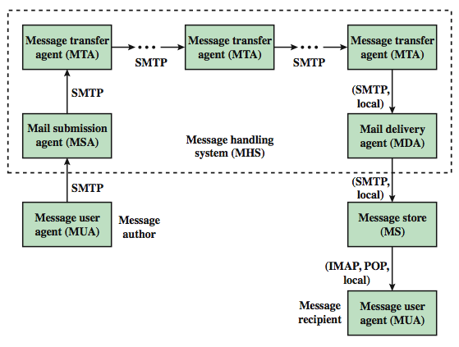
邮件协议架构
MUA: 信息用户代理
MSA: 信息提交代理
MTA: 信息传输代理
MDA:信息发送代理
MS: 信息存储
SMTP:简单邮件传输协议
POP：邮局协议
Notes:
To understand to operation of DKIM, it is useful to have a basic grasp of the Internet mail architecture, as illustrated in Stallings Figure 7.9. At its most fundamental level, the Internet mail architecture consists of a user world in the form of Message User Agents (MUA), and the transfer world, in the form of the Message Handling Service (MHS), which is composed of Message Transfer Agents (MTA). A MUA is usually housed in the user's computer, and referred to as a client email program, or on a local network email server. The MHS accepts a message from one User and delivers it to one or more other users, creating a virtual MUA-to-MUA exchange environment. The MSA accepts the message submitted by an MUA and enforces the policies of the hosting domain and the requirements of Internet standards. This function may be co-located with the MUA or be a separate functional model. In the latter case, the Simple Mail Transfer Protocol (SMTP) is used between the MUA and the MSA. The MTA relays mail for one application-level hop. Relaying is performed by a sequence of MTAs, until the message reaches a destination MDA. The MDA is responsible for transferring the message from the MHS to the MS. An MS can be located on a remote server or on the same machine as the MUA. Typically, an MUA retrieves messages from a remote server using POP (Post Office Protocol) or IMAP (Internet Message Access Protocol). Also an administrative management domain (ADMD) is an Internet email provider. The Domain Name System (DNS) is a directory lookup service that provides a mapping between the name of a host on the Internet and its numerical address.

Slide 20
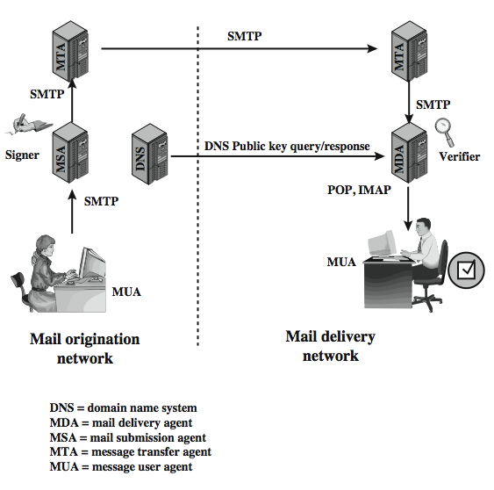
DKIM 设计
对用户透明
MSA sign
MDA verify
较务实
Notes:
DKIM is designed to provide an email authentication technique transparent to the end user. In essence, a user's email message is signed by a private key of the administrative domain from which the email originates. The signature covers all of the content of the message and some of the RFC 5322 message headers. At the receiving end, the MDA can access the corresponding public key via a DNS and verify the signature, thus authenticating that the message comes from the claimed administrative domain. Thus, mail that originates from somewhere else but claims to come from a given domain will not pass the authentication test and can be rejected. This approach differs from that of S/MIME and PGP, which use the originator's private key to sign the content of the message, for various pragmatic reasons (see text).
Stallings Figure 7.10 shows a simple example of the operation of DKIM. An email message is generated by an email client program. The content of the message, plus selected RFC 5322 headers, is signed by the email provider using the provider's private key. The signer is associated with a domain, which could be a corporate local network, an ISP, or a public email facility such as gmail. The signed message then passes through the Internet via a sequence of MTAs. At the destination, the MDA retrieves the public key for the incoming signature and verifies the signature before passing the message on to the destination email client. The default signing algorithm is RSA with SHA-256. RSA with SHA-1 may also be used.

Slide 21
总结
电子邮件安全
PGP
S/MIME
DKIM

